Slide 2

just what is the airspeed velocity of an unladen swallow?
So...

Slide 3
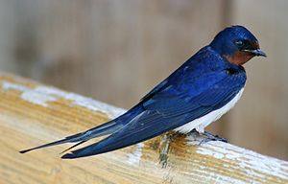
What do you mean?
An African or European swallow?
European
  Barn Swallow

Slide 4
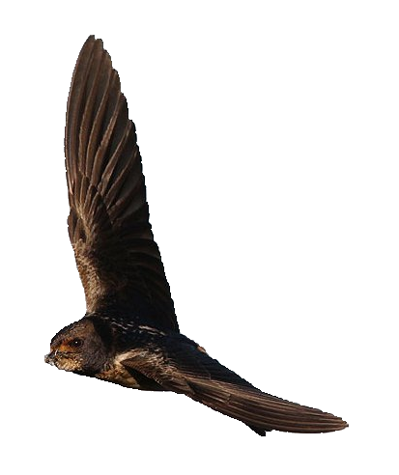
African
  Angola Swallow
  Bank Swallow
  Black-and-rufous Swallow
  Blue Swallow
  Ethiopian Swallow
  Forest Swallow
  Greater Striped Swallow
  Grey-rumped Swallow
  Lesser Striped Swallow
  Mosque Swallow
  Pearl-breasted Swallow
  Pied-winged Swallow
  Preuss's Swallow
  Red-chested Swallow
  Red-rumped Swallow
  Red Sea Swallow
  Red-throated Swallow
  Rufous-chested Swallow
  South African Cliff Swallow
  White-tailed Swallow
  White-throated Blue Swallow
  White-throated Swallow
  Wire-tailed Swallow

Slide 5
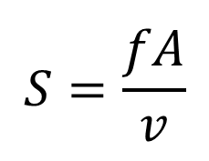
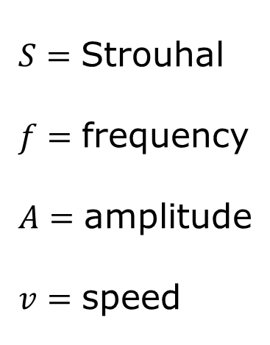
It's a simple question of weight ratios! A five ounce bird could not carry a one pound coconut.
$$S=\frac{fA}{v}$$
$$S=\text{Strouhal} \\ f=\text{frequency} \\ A=\text{amplitude} \\ v=\text{speed}$$

Slide 6
How do you know so much about swallows?
European
  Mass: 19g
  Wingspan: 33cm
  ~ Amplitude: 19cm
African
  Mass: 21g
  Wingspan: 27cm
  ~ Amplitude: 15cm

Slide 7
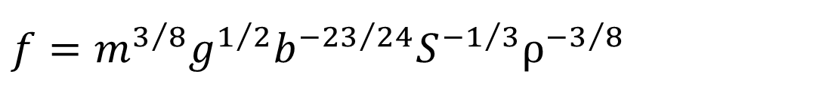
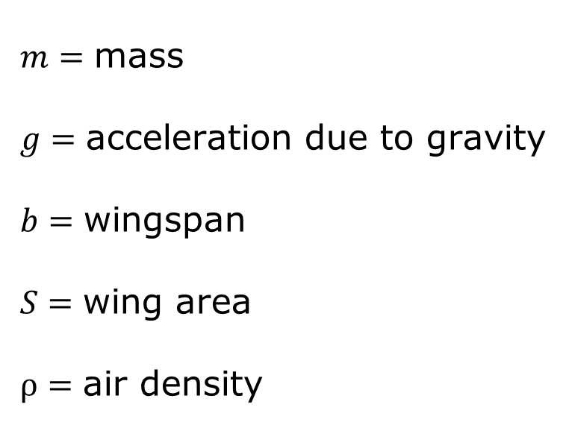
In order to maintain airspeed velocity, a swallow needs to beat its wings forty-three times every second, right?
$$f=m^{3/8}g^{1/2}b^{{−23}/{24}}S^{{−1}/3}ρ^{{−3}/8}$$
$$m=\text{mass} \\ g=\text{acceleration} \text{due} \text{to} \text{gravity} \\ b=\text{wingspan} \\ S=\text{wing} \text{area} \\ ρ=\text{air} \text{density}$$
Wingbeat frequency of birds in steady cruising flight: New data and improved predictions
C J Pennycuick, The Journal of Experimental Biology 199, 1613-1618 (1996)

Slide 8
You have to know these things when you're a king
European
  Mass: 19g
  Wingspan: 33cm
  Amplitude: 19cm
  Frequency: 8Hz
African
  Mass: 21g
  Wingspan: 27cm
  Amplitude: 15cm
  Frequency: 11Hz

Slide 9
What is the airspeed velocity of an unladen swallow?
European
  9.2 m/s
  20.6 mph
  0.88 Bolt
African
  10.4 m/s
  23.3 mph
  1 Bolt

Slide 10
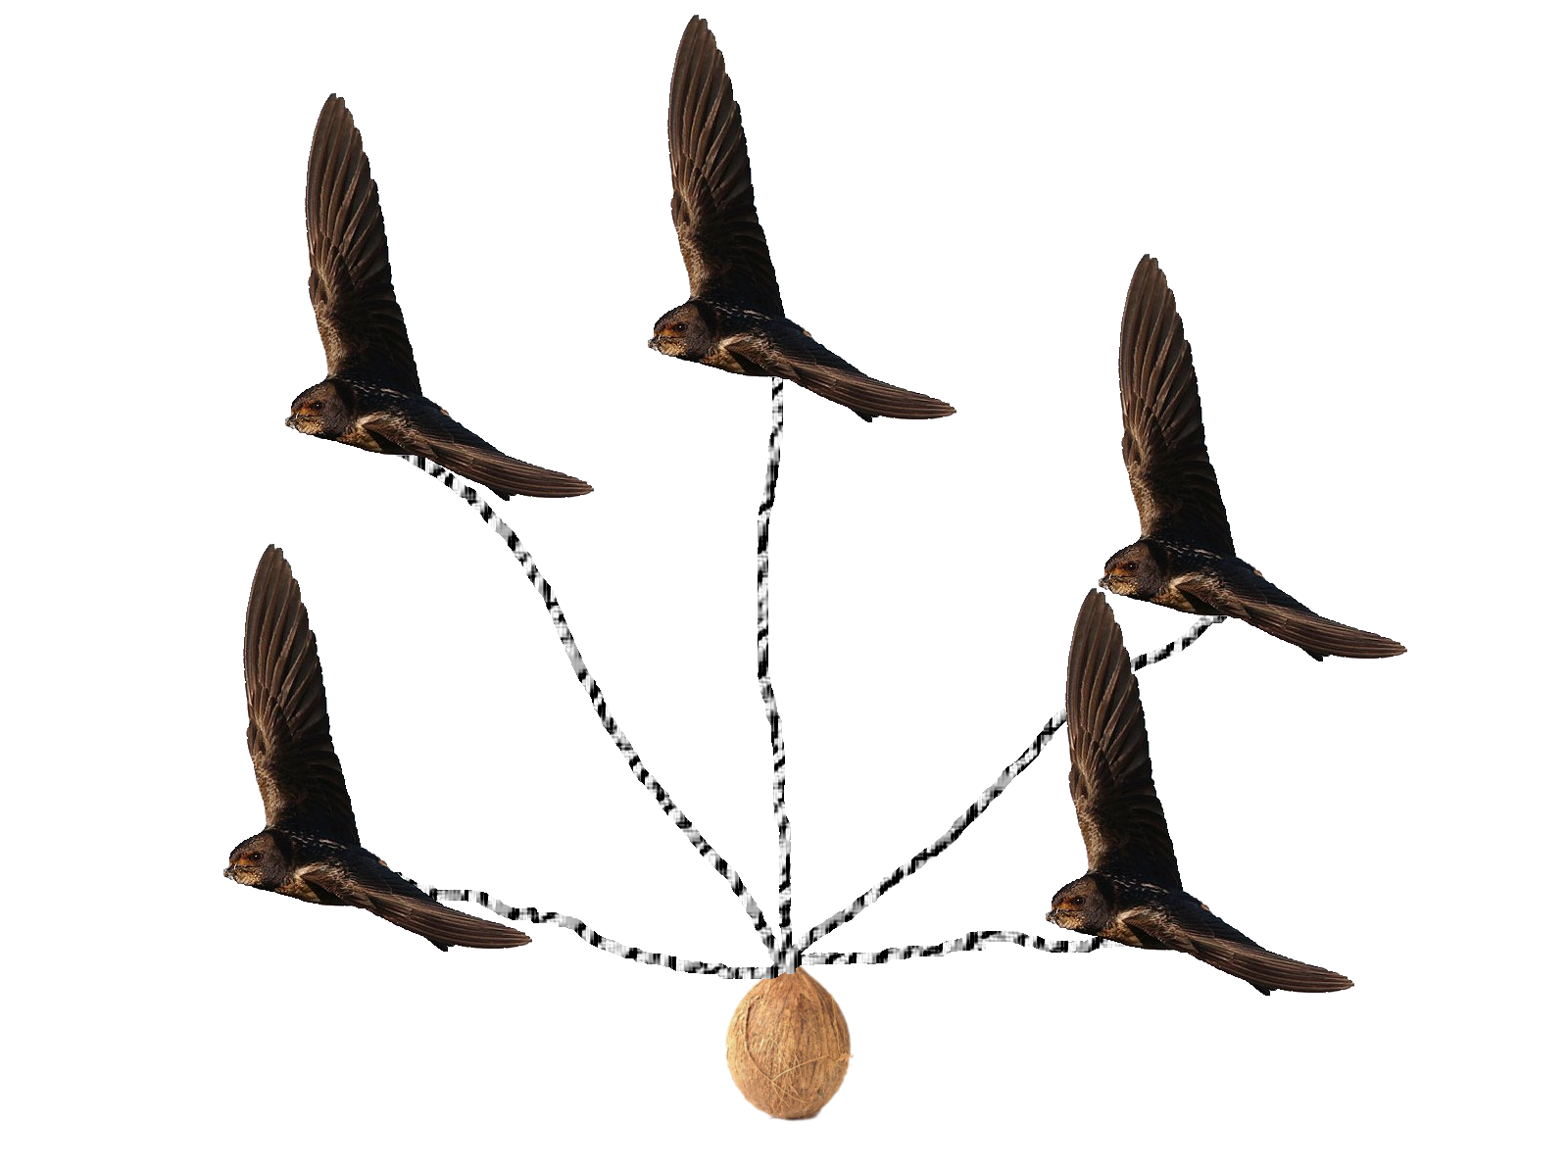
One, two, five
In case you were wondering:
  At least 5 swallows would be needed to carry a coconut

